Slide 1
Patient Centered End of Life Care IPE Activity Preparation
This Phoo by Unknown Author is licensed under CC BY-NC-ND
BSCN & RT IPE Activity Fall 2023

Slide 2
Preparation for the activity
Please use this slide deck as a guided preparatory experience.
Information presented in this slide is not new content, but it may be presented in a different way to support your review and critical thinking
The information in this slide deck is required to effectively and collaboratively complete the IPE activity

Slide 3
To Begin – Key terminology
Living with a chronic condition may mean coping with pain or fear, adapting to new physical limitations, or handling social or job-related stresses, in addition to dealing with disease-related symptoms.
The term self-management refers to “the tasks that an individual must undertake to live well with one or more chronic conditions.
Self-management support is “the systematic provision of education and supportive interventions, by health care staff (and others), to increase patients’ skills and confidence in managing their health problems
https://www.selfmanagementbc.ca/uploads/HCC_SelfManagementReport_FA.pdf
Notes:
Health council of Canada (2012). Self-management support for Canadians with chronic health conditions. Retrieved from https://www.selfmanagementbc.ca/uploads/HCC_SelfManagementReport_FA.pdf

Slide 4
Approximately half of all Canadians are living with at least one chronic health condition, and more than one in four Canadians report having two or more chronic conditions. Many will live well and long despite having a long-term health concern, but others will not.
Notes:
https://www.selfmanagementbc.ca/uploads/HCC_SelfManagementReport_FA.pdf

Slide 5
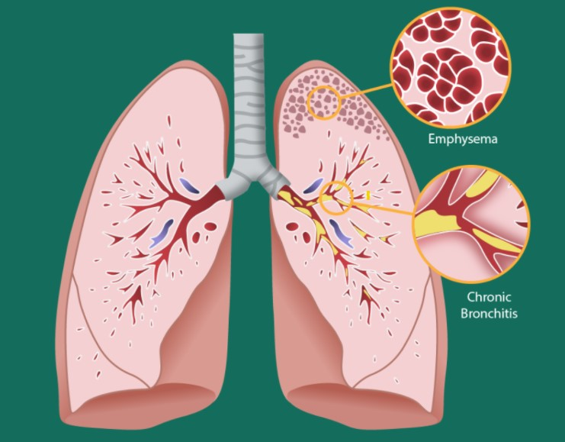
What is Chronic Obstructive Pulmonary Disease (COPD)?
What is it?
“… a common, preventable, and treatable disease that is characterized by persistent respiratory symptoms and airflow limitation that is due to airway and/or alveolar abnormalities usually caused by…” GOLD 2023
Caused by?
Is it reversible?
What is the difference between COPD, emphysema, and chronic bronchitis?
Notes:
GOLD 2023 report: © 2022,2023 Global Initiative for Chronic Obstructive Lung Disease, available from www.goldcopd.org, published in Deer Park, IL, USA.
Image: What is COPD? – SwipeRx (swiperxapp.com)

Slide 6
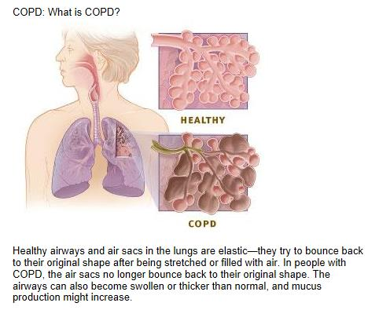
COPD Patho Basics
Emphysema:
Emphysema video
Chronic bronchitis:
What are characteristics of this pathophysiology? How is it different than Emphysema?
COPD often features of both
Notes:
Video: https://youtu.be/TEuSV_7gWA8?si=K-Ql_r8VOYjOP9aU “Emphysema” by Osmosis (start at 3:22, end 5:01)
Image: Chronic Conditions | Lifespan Development (lumenlearning.com)

Slide 7
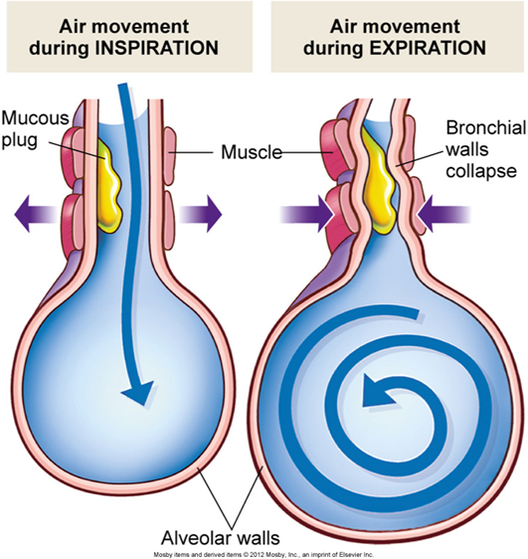
Air trapping
What is Air Trapping?
What is the relationship between air trapping and hyperinflation?
Is COPD an Obstructive or Restrictive lung disease?
Consider the similarities and difference between obstructive and restrictive lung disorders
Notes:
Image: Smoke Doesn't Cause Asthma Attacks, It Causes Respiratory Attacks (airphysio.com)
Air trapping due to loss of elastic recoil (emphysema), mucus plugging (CB) and inflammation. Airways are floppy with poor tone, get smaller naturally when we exhale so the problem is exacerbated. May be used interchangeably with hyperinflation. Persistent airtrapping = hyperinflation
Obstructive
During exercise - increased RR = less time to exhale, worsening obstruction and hyperinflation. Dynamic hyperinflation

Slide 8
Classic Signs & Symptoms of COPD
Most common S&S:
Dyspnea, especially with:
+/- persistent Cough
+/- sputum production
What is the term used to describe episodes of increased symptoms?
S & S can be insidious in nature, what does this mean?
Notes:
Image: Clinical Challenge: Elderly Man Presents With Dyspnea at Rest and Chronic Cough - Pulmonology Advisor

Slide 9
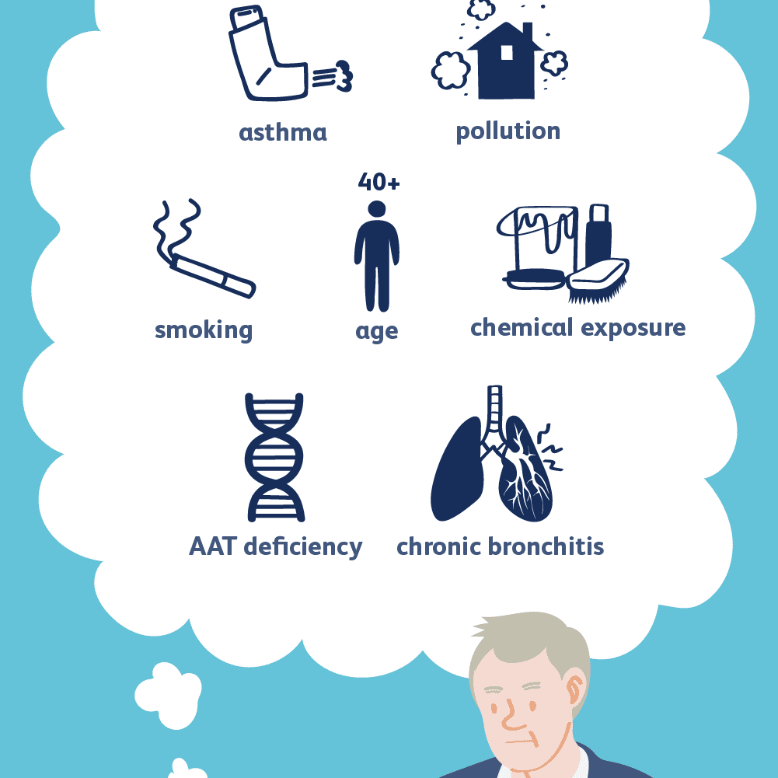
COPD Causes and Risk Factors
Usually a 2° response to an inflammatory response to noxious particles
Main risk factor?
↑ exposure = increased risk of __________
COPD in “never smokers” - what are some causes?
Genetic components to consider
A1AT Deficiency
Abnormal Lung development
Accelerated aging
Notes:
Image: COPD Causes and Risk Factors (verywellhealth.com)

Slide 10
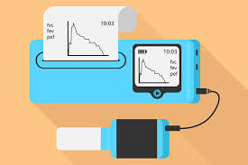
What is required to definitively Diagnose COPD?
1.
2.
3.
Notes:
Spirometry confirming airflow obstruction POST bronchodilator (FEV1/FVC < 0.70 post-bronchodilator, FEV1 classifies severity)
History of exposure or genetic condition
Presence of associated symptoms (dyspnea, cough, sputum)

Slide 11
COPD Diagnosis – now what?
COPD management and treatment goals:
Slow disease progression
Reduce disease burden
Manage symptoms
Improve function and health
Reduce and Rx exacerbations
Reduce morbidity and early mortality
Improve quality of life
Notes:
Image: Five Smart Low-Impact Exercises for People with COPD (oxygenconcentratorstore.com)

Slide 12
Self Management
What is it?
Goals
↑ independence
Pt is part of care team
Reduced reliance on resources
Improved QOL
https://www.livingwellwithcopd.com/

Slide 13
Who are successful “Self-managers” of Chronic Disease?
Successful self-managers
Are knowledgeable about condition and how to improve their quality of life
motivated, prioritize self-care and have high self-efficacy
Follow a personal care plan developed in partnership with their HCP
Are active in personal decision-making and are ready to change health habits
Monitor and manage symptoms and can problem-solve their management
Are supported by family, friends and/or peers
Adopt lifestyles that promote health
Have access to support services and ability to use them.
Have primary care providers
Notes:
Resources: https://bmjopen.bmj.com/content/9/5/e028344 & Self-management support
Gobeil-Lavoie A, Chouinard M, Danish A, et alCharacteristics of self-management among patients with complex health needs: a thematic analysis reviewBMJ Open 2019;9:e028344. doi: 10.1136/bmjopen-2018-028344
https://bmjopen.bmj.com/content/9/5/e028344

Slide 14
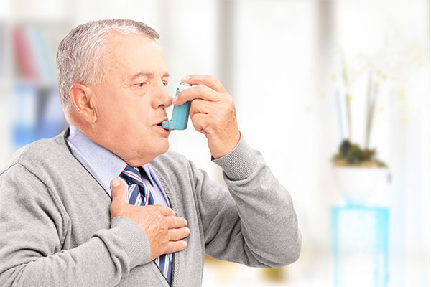
Key Areas of Self-Management of COPD
Skills Mastery
Device teaching
>90% make errors w/ MDI + spacer¹
Goal Setting
Problem Solving
Resource Utilization
Referrals
Educational resources
Taking Action
1. Chrystyn et al. Device errors in asthma and COPD: systematic literature review and meta-analysis. npj Prim Care Resp Med 27, 22 (2017). https://doi.org/10.1038/s41533-017-0016-z
Notes:
Article: Device errors in asthma and COPD: systematic literature review and meta-analysis | npj Primary Care Respiratory Medicine (nature.com)

Slide 15
Why Self-management is Difficult?
Personal challenges
Finances, competing life priorities, achieving change
Systems
Programs not tailored to needs, access (work, childcare, transportation), communication
Disease-related challenges
Depression, pain, impaired mobility
Drug interactions
Health literacy – complex information
Conflicting advice
Can you think of others?
https://www.selfmanagementbc.ca/uploads/HCC_SelfManagementReport_FA.pdf
Notes:
Remember chronic health management is complex. There is no clear path to successful management.
Every patient is different, every management plan is unique to the patients needs

Slide 16
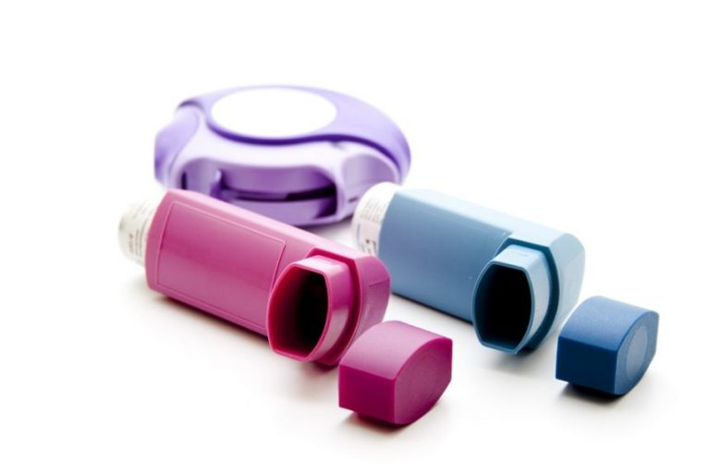
Providing Self-care management support
Remember each person is unique!
Same diagnosis ≠ same clinical presentation
Recognize there is variable function, motivation, support
How care we be client-centered?
Notes:
Image: Inhalers (Asthma & COPD Treatment) Explained Clearly - HealthLynked
Individual care and treatment
Client-centered: medications or devices (e.g. client with arthritis), smoking cessation interventions (e.g. providing info on what is funded), individual exercise goal setting (getting back to walking with friends), teaching positions for SOB that work for that individual

Slide 17
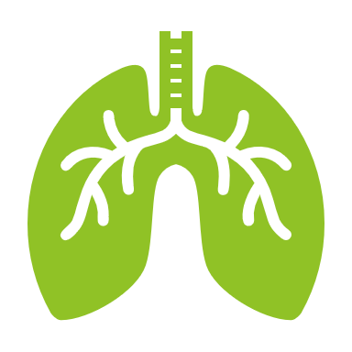
COPD Progression
Connect these signs and systems to the progression and physiological changes caused by the disease
Easily fatigued
Frequent respiratory infections
Use of accessory muscles to breathe
Orthopnea
Wheezing
Pursed-lip breathing
Chronic cough
Barrel chest
Dyspnea
Barrel chest
Prolonged expiratory time
Thin appearance
Cor pulmonale

Slide 18
Why is Advanced-care planning so important?
Allows client to
THINK about values, beliefs and wishes
HONOUR personal, cultural and/or spiritual traditions
TALK with family about your wishes and instructions
GUIDE health-care team to give you the care that is right for you
DECIDE who to speak for them, when unable to able to speak for themselves
RECORD wishes
HAVE peace of mind about financial and legal affairs
Notes:
https://www.interiorhealth.ca/sites/default/files/PDFS/advance-care-planning-is-for-everyone-brochure.pdf

Slide 19
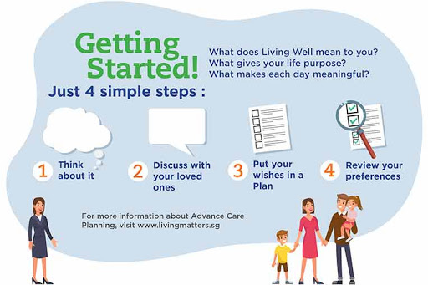
Advanced Care Planning
Advanced care planning is deeply personal. Should be individualized and client-centered.
Do you know what you would want? Your family?
Who should have an advanced directive?
Proxy directive
In the face of terminal illness:
One patient/family may want everything done
Another patient/family may want comfort care
Notes:
Image: http://www.phna.info/advance-care-planning.html

Slide 20
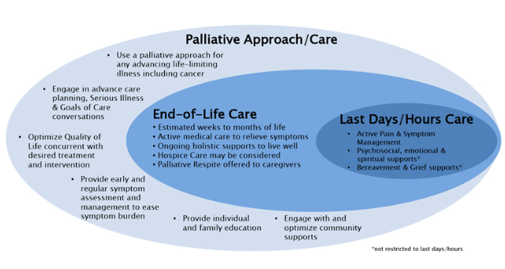
What is Palliative Care?
Improving QOL for pts living with a life-threatening illness
Review the goals of palliative care from your prior learning.
https://www.interiorhealth.ca/YourCare/PalliativeCare/Pages/WhatIsPalliative.aspx

Slide 21
EOL (Comfort) Care
Can occur days, weeks to months before death
EOL is still active care, focused on ↓ discomfort + pain
Is person-centered
Supports both client and family
Can occur at home, in hospital, hospice and respite care is available
https://www.interiorhealth.ca/YourCare/PalliativeCare/Pages/WhatIsPalliative.aspx

Slide 22
Some considerations from your IPE facilitator team about EOL care as a student or as new healthcare professionals
EOL experiences will have an emotional impact on you. They are often emotional but gratifying
You will attend to the physical, spiritual and psychosocial needs of the patient and family while experiencing your own learning about the death experience
EOL care can highlight limitations of life (in)experience and that is OK and normal
Spend some time thinking about your strengths that can help you provide EOL care?

Slide 23
Final thoughts “A Good Death”
“A good death is one that is free from avoidable distress and suffering, for patients, family, and caregivers; in general accord with the patients’ and families’ wishes; and reasonably consistent with clinical, cultural, and ethical standards.” (Field & Cassel, 1997)
Come to the IPE activity prepared to support our client through the health transitions of chronic and progressive illness
Notes:
Field MJ, Cassel CK, editors. Approaching Death: Improving Care at the End of Life. Washington, DC: National Academy Press; 1997.

